Slide 1





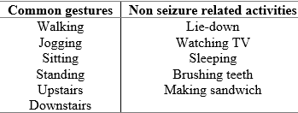
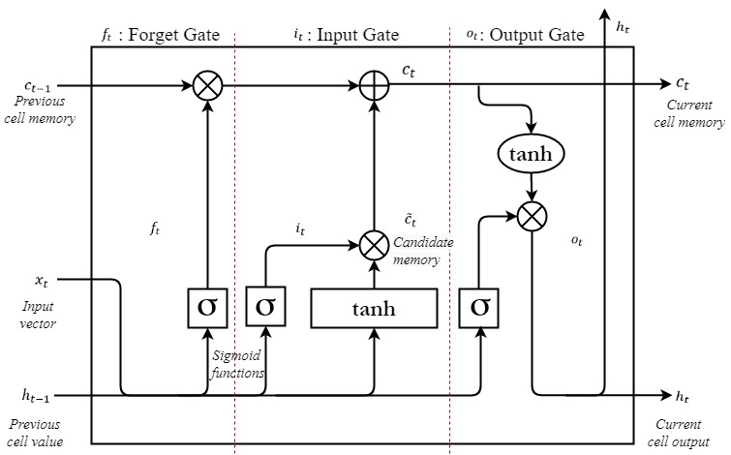
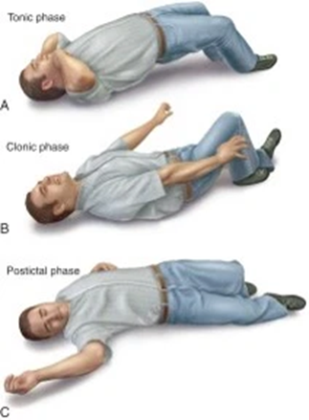
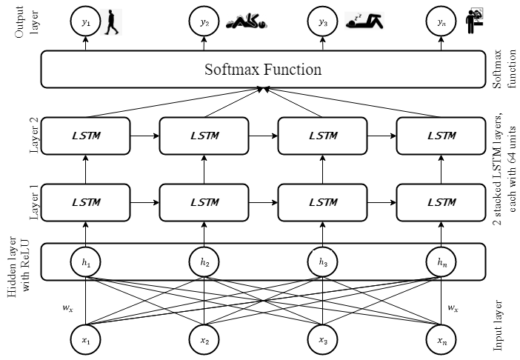
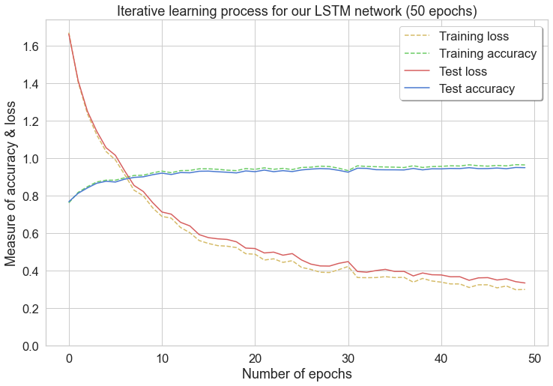
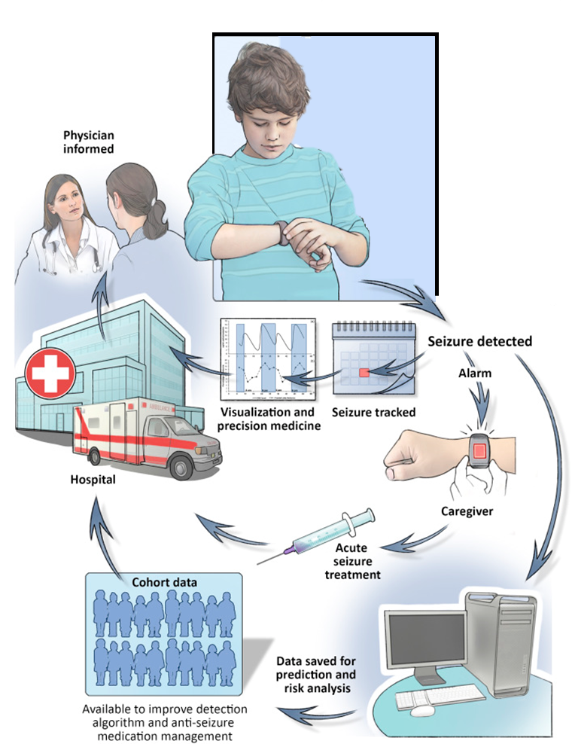
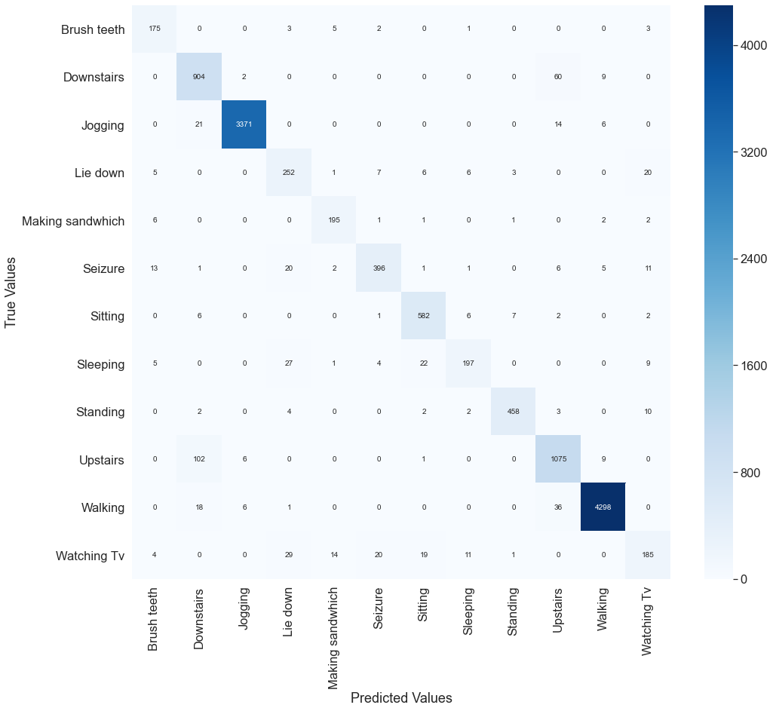
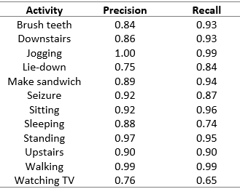

Long term, In-home Detection of Epileptic Seizures
Jamie Pordoy
Student ID: 21345470
Email: 21345470@student.uwl.ac.uk
Abstract
Methodology
Abstract - Nearly one third of those diagnosed with epilepsy are classed as refractory and have a form of drug resistant epilepsy. Despite optimal treatments at a therapeutic level, these patients continue to experience frequent and uncontrolled seizures. The unpredictability and frequency of these seizures can have a detrimental effect on a person with epilepsy (PWE), which can lead to injury, a reduced mental state, or a sudden unexpected death in epilepsy (SUDEP). SUDEP is the predominate cause of death accounting for 38% of epilepsy-related fatalities and often takes place after a PWE has had an epileptic seizure. The gold standard for early seizure detection is the electroencephalogram (EEG), where scalp-based electrodes are used to measure the brain’s electrical activity. Whilst this method of detection has been shown to be highly accurate, most SUDEP cases are nocturnal, and occur whilst a patient is unsupervised and asleep. Therefore, there is need of a long-term, in-home method of detection that can identify epileptic seizures in real-time and notify caregivers so that intervention can occur. The aim of this poster presentation is to present my research and findings on this topic and discuss how I am using artificial intelligence (AI), Internet of things (IoT) and Edge computing to tackle this issue.
.
Data Collection
In this study, we collected data from 10 participants (eight healthy adults and two with juvenile myoclonic epilepsy (JME)) using a wrist worn tri-axial ACM and gyroscope operating at a frequency of 25Hz.
Figure 3: Participant recording movements
Spanning a 48-hour period, participants were instructed to carry out the series of activities and rhythmic movements listed in Table 1. Activities were chosen based on movements that share similar coordinates in three-dimensional space with an epileptic seizure.
Table 1: Movements recorded for this study
Introduction
Neural Network
To perform experiments on the data, we developed a long short-term memory (LSTM) network as they use control gates to regulate dependencies and model time series data efficiently. Our model consists of 2 LSTM layers with 64 units in each and 2 fully connected layers.
Epilepsy is a commonly occurring neurological condition that affects an estimated 70 million people. The brain experiences an overload of electrical activity culminating in an unprovoked epileptic seizure, which often leaves an individual with a loss of motor functions and clarity of memory.
30% of those diagnosed have drug resistant epilepsy and have an increased risk of early mortality when compared to non-epileptics, as medical treatments and therapies are ineffective [1].
Generalised epileptic seizures consist of 3 separate phases, tonic, clonic and postictal
First is the tonic, where the PWE experiences a series of small twitches and then a tightening of the muscles. This is followed by the clonic phase where the person jerks violently and struggles to breath. During this phase they are susceptible to affixation. Finally, the postictal phase occurs when the muscles uncontract, and the patient begins to breath normally
Figure 4: LSTM unit architecture
To improve performance, we then stacked our LSTM
layers so that our data can be processed at different
time intervals.
Finally, we used a softmax activation function to output a vector of multiple probabilities, where each probability correlates to one of the movements in our dataset.
Figure 5:Architectural schematic of our stacked LSTM network with softmax function
Results
Figure 1: Phases of a tonic-clonic seizure
We conducted a series of experiments to evaluate the performance of our LSTM network when distinguishing the different types of movement in 3-dimensions. Figure 6 is a mathematical representation of our models incremental learning process. Performance is evaluated using classification accuracy, whilst the network is optimized using cross-entropy loss. As accuracy increases the loss value decreases until they both stabilise at 35 and 50 epochs, respectively.
Seizure Detection
The most promising method of non-EEG detection uses accelerometers (ACM) to measure a patient's movements in 3-dimensional space.
Whilst the number of false predictions is well documented in ACM detection studies, there is an observable commonality regarding how models are trained. Algorithms are trained using sequential event prediction, where the measurements from past seizures are used to predict future occurrences [2].
Whilst this process of training has been successful in other domains, the temporal motions observed during onset need to be classed as idiosyncratic, as no two seizures are likely to share the same set of events (location, positioning, duration).
To overcome this problem, seizure detection algorithms need to be able to distinguish different types of non-seizure related movement from the rhythmic jerking and muscle spasms seen during a convulsion [4]. To achieve this, seizure detection algorithms need to be trained using data from past seizures as well as data from common activities that share a similar position in 3-dimensional space.
.
Figure 6: Learning and loss curve for stacked LSTM network
To evaluate how well our model can distinguish the different types of movement, we used a multi-label confusion matrix (Figure 7). The diagonal elements represent the true positive predictions indicating the number of times our model made a correct prediction. The remaining values indicate incorrect classifications. Horizontal values represent false negatives, whilst vertical values represent false positives.
Figure 2: Common closed loop ACM detection system
Aims and Objectives
Figure 7: Confusion Matrix results
Therefore, the aim of this research is to develop a long short-term memory (LSTM) neural network for sequential classification that can distinguish commonly occurring movements from the clonic jerking and spasms observed during a generalised seizure.
Research Objectives
To recorded 3-dimensional data on commonly occurring movements and merge with pre-recorded data of generalised seizures to create a new dataset.
Develop a new deep learning model that can interpret 3-dimensional, time-series data.
Train the model to distinguish different movements from a generalised seizure and evaluate the results.
Table 2 lists the results of our precision and recall experiments. Precision results represent the proportion of positive predictions that were made. The network distinguished epileptic seizures from other non-seizure related movements 92% of the time. A recall value of 87% was observed when identifying seizure movements, which indicates the number of times a positive value was correctly identified for that class. Furthermore, our model struggled to differentiate the watching TV activity from other types, resulting in a precision and recall value of 76% and 65% respectively.
Table 2: Precision and Recall scores
Conclusions
This paper presents a deep learning method for accelerometer-based detection of generalised seizures. Using the raw acceleration data collected, an LSTM neural network was developed that can make distinctions between common movements and generalised seizures. Whilst movements such as watching TV and lying down scored lower, we theorize that this occurred as other movements such as sleeping share similar positions in 3-dimensional space. Such factors need to be accounted for in future research and could potentially help to improve overall performance. To conclude, our stacked LSTM network successfully differentiated epileptic seizures from other types of movement, with a precision value of 87%, whilst we measured 94.97% with a loss of 0.334% for classification accuracy and loss. This study provides a novel approach for ACM detection and could help to reduce the number of false predictions seen in commercial systems and provide a greater depth to the accelerometer modality as it can now distinguish different movements when detecting generalised seizures.
/tests-procedures/echocardiogram/about/pac-20393856 [Accessed 9 Dec. 2019].
References
Contact Me
[1] French J. Refractory epilepsy: clinical overview. Epilepsia, 2007; 48(1):3-7. [2] Van de Vel A, Cuppens K, Bonroy B et al, Non-EEG seizure-detection systems and potential SUDEP prevention: State of the art. Seizure, 2013; 22(5):345-355. doi:10.1016/j.seizure.2013.02.012 [3] Beniczky S, Polster T, Kjaer T et al. Detection of generalized tonic-clonic seizures by a wireless wrist accelerometer: A prospective, multicenter study. Epilepsia, 2013; 54(4):e58-e61. | For further information on the research presented in this poster please feel free to read the journal publication using the following URL link and citation. https://researchlakejournals.com/index.php/AAIML/article/view/30 Pordoy J, Zhang Y, Matoorian N, et al. Predicting Epileptic Seizures with a Stacked Long Short-Term Memory Network. Int J Auto AI Mach Learn. 2020;1(1):93-108

